Slide 1
W4111 – Introduction to Databases Section 002, Spring 2022 Lecture 5: ER, Relational, SQL (IV)
© Donald F. Ferguson, 2022

Slide 2

Contents
2 | Introduction to Databases (S22): Lecture 5: ER, Relational, SQL (IV) © Donald F. Ferguson, 2022

Slide 3
Codd’s Rules Metadata, Integrity
3 | Introduction to Databases (S22): Lecture 5: ER, Relational, SQL (IV) © Donald F. Ferguson, 2022

Slide 4
Codd’s 12 Rules
Rule 1: Information Rule
The data stored in a database, may it be user data or metadata, must be a value of some table cell. Everything in a database must be stored in a table format.
Rule 2: Guaranteed Access Rule
Every single data element (value) is guaranteed to be accessible logically with a combination of table-name, primary-key (row value), and attribute-name (column value). No other means, such as pointers, can be used to access data.
Rule 3: Systematic Treatment of NULL Values
The NULL values in a database must be given a systematic and uniform treatment. This is a very important rule because a NULL can be interpreted as one the following − data is missing, data is not known, or data is not applicable.
Rule 4: Active Online Catalog
The structure description of the entire database must be stored in an online catalog, known as data dictionary, which can be accessed by authorized users. Users can use the same query language to access the catalog which they use to access the database itself.
Rule 5: Comprehensive Data Sub-Language Rule
A database can only be accessed using a language having linear syntax that supports data definition, data manipulation, and transaction management operations. This language can be used directly or by means of some application. If the database allows access to data without any help of this language, then it is considered as a violation.
Rule 6: View Updating Rule
All the views of a database, which can theoretically be updated, must also be updatable by the system.

Slide 5
Codd’s 12 Rules
Rule 7: High-Level Insert, Update, and Delete Rule
A database must support high-level insertion, updation, and deletion. This must not be limited to a single row, that is, it must also support union, intersection and minus operations to yield sets of data records.
Rule 8: Physical Data Independence
The data stored in a database must be independent of the applications that access the database. Any change in the physical structure of a database must not have any impact on how the data is being accessed by external applications.
Rule 9: Logical Data Independence
The logical data in a database must be independent of its user’s view (application). Any change in logical data must not affect the applications using it. For example, if two tables are merged or one is split into two different tables, there should be no impact or change on the user application. This is one of the most difficult rule to apply.
Rule 10: Integrity Independence
A database must be independent of the application that uses it. All its integrity constraints can be independently modified without the need of any change in the application. This rule makes a database independent of the front-end application and its interface.
Rule 11: Distribution Independence
The end-user must not be able to see that the data is distributed over various locations. Users should always get the impression that the data is located at one site only. This rule has been regarded as the foundation of distributed database systems.
Rule 12: Non-Subversion Rule
If a system has an interface that provides access to low-level records, then the interface must not be able to subvert the system and bypass security and integrity constraints.

Slide 6
Metadata and Catalog
‘Metadata is "data that provides information about other data". In other words, it is "data about data". Many distinct types of metadata exist, including descriptive metadata, structural metadata, administrative metadata, reference metadata and statistical metadata.’ (https://en.wikipedia.org/wiki/Metadata)
“The database catalog of a database instance consists of metadata in which definitions of database objects such as base tables, views (virtual tables), synonyms, value ranges, indexes, users, and user groups are stored. ... ... The SQL standard specifies a uniform means to access the catalog, called the INFORMATION_SCHEMA, but not all databases follow this ...” (https://en.wikipedia.org/wiki/Database_catalog)
Codd’s Rule 4: Dynamic online catalog based on the relational model:
The data base description is represented at the logical level in the same way as ordinary data, so that authorized users can apply the same relational language to its interrogation as they apply to the regular data.

Slide 7
Data Definition Language (DDL)
Specification notation for defining the database schema
Example: create table instructor ( ID char(5), name varchar(20), dept_name varchar(20), salary numeric(8,2))
DDL compiler generates a set of table templates stored in a data dictionary
Data dictionary contains metadata (i.e., data about data)
Database schema
Integrity constraints
Primary key (ID uniquely identifies instructors)
Authorization
Who can access what
Notes:
7

Slide 8
Data Dictionary Storage
The Data dictionary (also called system catalog) stores metadata; that is, data about data, such as
Information about relations
names of relations
names, types and lengths of attributes of each relation
names and definitions of views
integrity constraints
User and accounting information, including passwords
Statistical and descriptive data
number of tuples in each relation
Physical file organization information
How relation is stored (sequential/hash/…)
Physical location of relation
Information about indices (Chapter 14)

Slide 9
Relational Representation of System Metadata
Relational representation on disk
Specialized data structures designed for efficient access, in memory

Slide 10
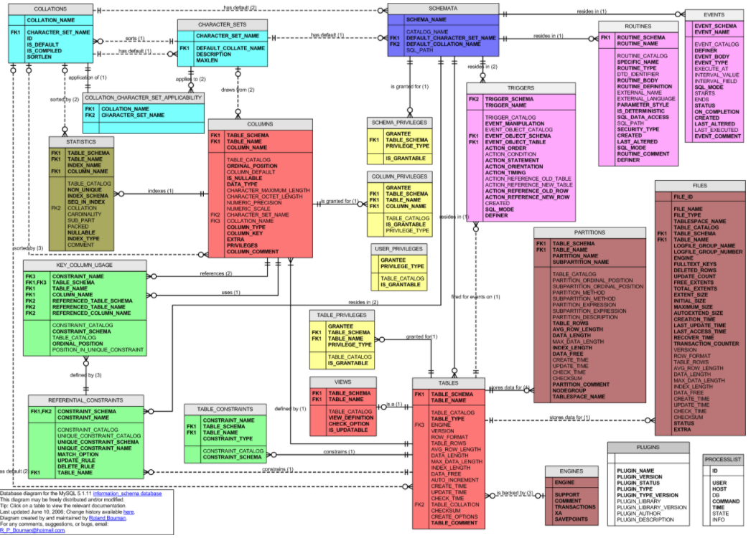
MySQL Catalog (Information_Schema)
Some of the MySQL Information Schema Tables:
'ADMINISTRABLE_ROLE_AUTHORIZATIONS'
'APPLICABLE_ROLES'
'CHARACTER_SETS'
'CHECK_CONSTRAINTS'
'COLUMN_PRIVILEGES'
'COLUMN_STATISTICS'
'COLUMNS'
'ENABLED_ROLES'
'ENGINES'
'EVENTS'
'FILES'
'KEY_COLUMN_USAGE'
'PARAMETERS'
'REFERENTIAL_CONSTRAINTS'
'RESOURCE_GROUPS'
'ROLE_COLUMN_GRANTS'
'ROLE_ROUTINE_GRANTS'
'ROLE_TABLE_GRANTS'
'ROUTINES'
'SCHEMA_PRIVILEGES'
'STATISTICS'
'TABLE_CONSTRAINTS'
'TABLE_PRIVILEGES'
'TABLES'
'TABLESPACES'
'TRIGGERS'
'USER_PRIVILEGES'
'VIEW_ROUTINE_USAGE'
'VIEW_TABLE_USAGE'
'VIEWS'
CREATE and ALTER statements modify the data.
DBMS reads information:
Parsing
Optimizer
etc.

Slide 11
Usage Example: Basic Steps in Query Processing
1. Parsing and translation
2. Optimization
3. Evaluation
Database Catalog
Tables, columns, types, ... needed to check syntax.
Statistics used for cost based optimization and plans.

Slide 12
Some More Relational Algebra
12 | Introduction to Databases (S22): Lecture 5: ER, Relational, SQL (IV) © Donald F. Ferguson, 2022

Slide 13
Some Additional Operations
Left and right join
⟕
⟖
⟗
Semi-join
⋉
⋊
Anti-join: ▷
Order By: τ
Group By: γ
Division: ÷
Many of these are obscure, and many SQL implementations do not support.
You can “derive” them from other operations in many cases.
They are so obscure that the textbook does not cover some of them.

Slide 14
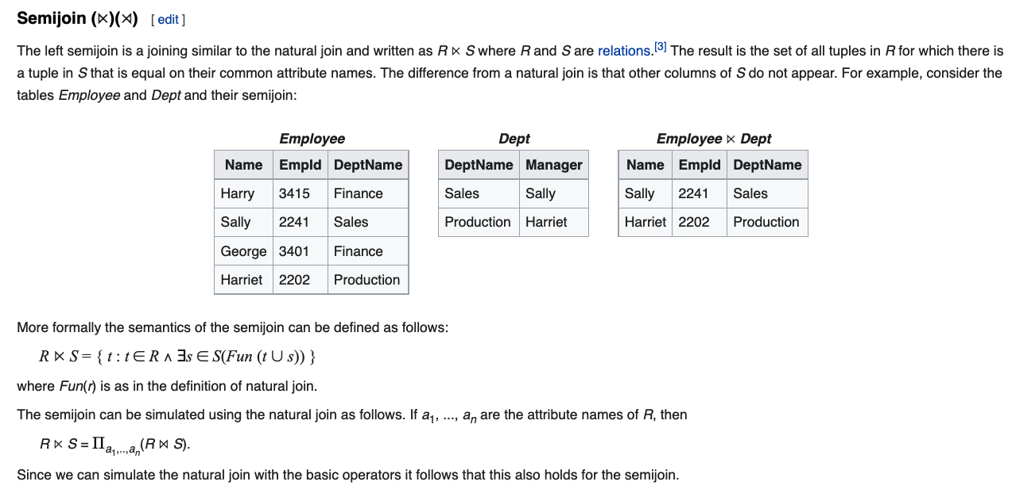
Semi-Join

Slide 15
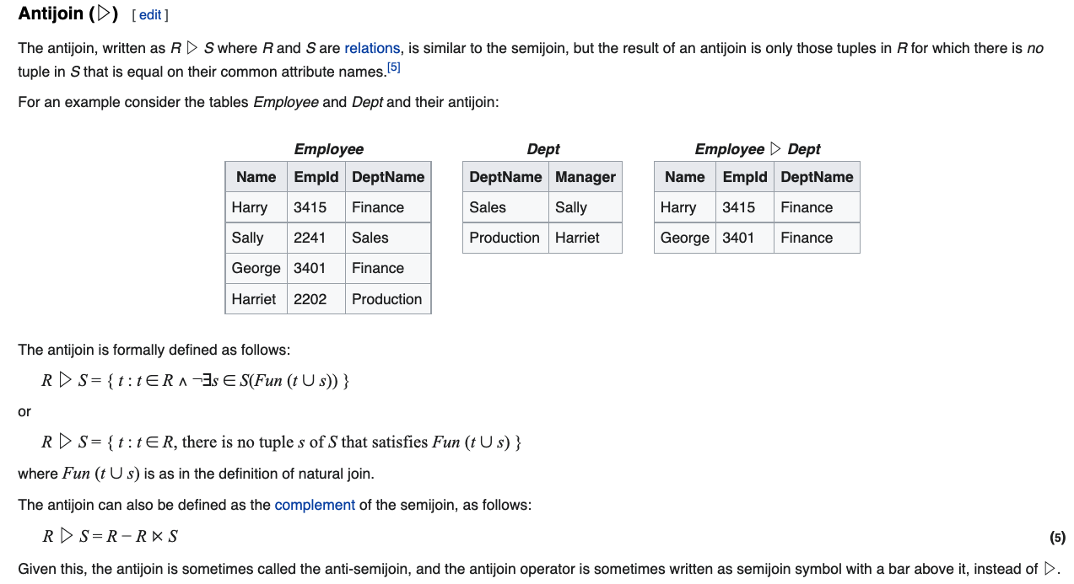
Anti-Join

Slide 16
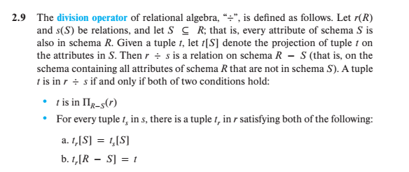
Division
Well, that is crystal clear.
My head hurts every time I must remember this for that one slide every semester. But, this makes a cool exam question!

Slide 17
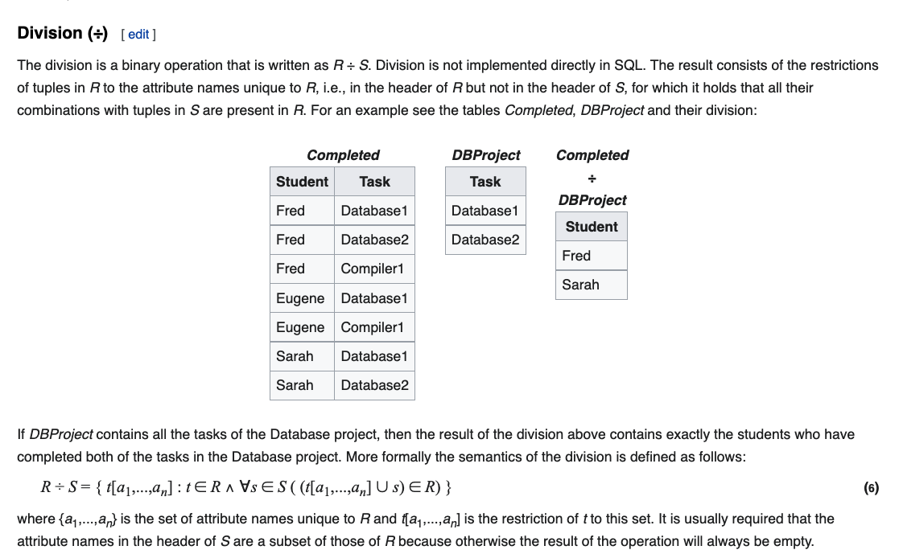
Division

Slide 18
More Complex JOIN and Sets
18 | Introduction to Databases (S22): Lecture 5: ER, Relational, SQL (IV) © Donald F. Ferguson, 2022

Slide 19

Set Operation Basics
19 | COMS W4111_002_2022_1: Lecture 3: ER, Relational, SQL (III) © Donald F. Ferguson, 2022

Slide 20
Set Operations

Slide 21
One Way to Think About Joins

Slide 22
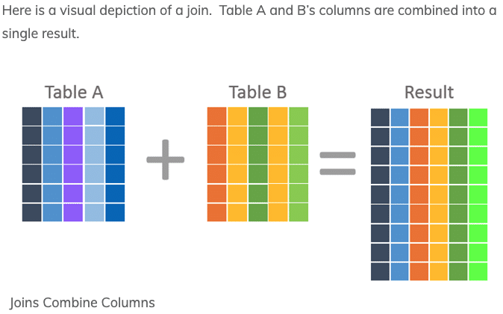
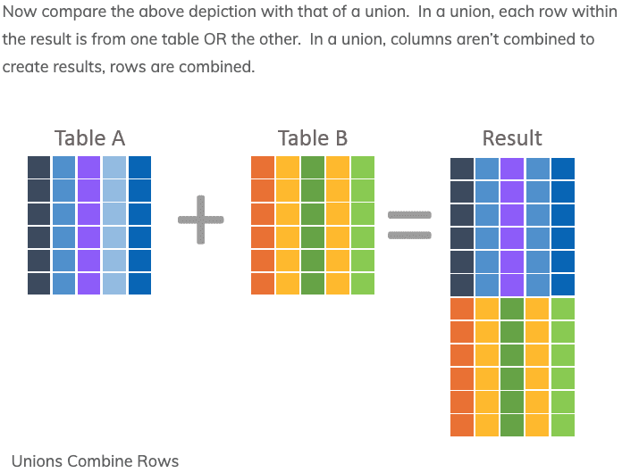
JOIN and UNION (and Set Operations)
UNION vs JOIN can be confusing. Basically,
JOIN puts the tables together “side by side.”
Union puts the tables together “one on top of the oter.”

Slide 23
RDBMS and Set Operations
The SQL set operations are:
UNION
SELECT
EXCEPT
Virtually all SQL implementations support UNION.
Support for INTERSECT and EXCEPT is less consistent. Can be implemented using other primitives.
We will some examples with another database that we will use. (Switch to notebook)

Slide 24
Set Comparisons
24 | COMS W4111_002_2022_1: Lecture 3: ER, Relational, SQL (III) © Donald F. Ferguson, 2022

Slide 25
Set Comparison

Slide 26
Set Comparison – “some” Clause
Find names of instructors with salary greater than that of some (at least one) instructor in the Biology department.
Same query using > some clause
select distinct T.name
from instructor as T, instructor as S
where T.salary > S.salary and S.dept name = 'Biology';
select name
from instructor
where salary > some (select salary
from instructor
where dept name = 'Biology');

Slide 27
Definition of “some” Clause
F <comp> some r ⇔ ∃ t ∈ r such that (F <comp> t ) Where <comp> can be: <, ≤, >, =, ≠
0
(5 < some
5
) = true
(read: 5 < some tuple in the relation)
6
0
(5 < some
5
) = false
0
(5 = some
) = true
5
0
(5 ≠ some
5
) = true (since 0 ≠ 5)
(= some) ≡ in
However, (≠ some) ≡ not in

Slide 28
Set Comparison – “all” Clause
Find the names of all instructors whose salary is greater than the salary of all instructors in the Biology department.
select name
from instructor
where salary > all (select salary
from instructor
where dept name = 'Biology');

Slide 29
Definition of “all” Clause
F <comp> all r ⇔ ∀ t ∈ r (F <comp> t)
0
(5 < all
5
) = false
6
6
(5 < all
) = true
10
4
(5 = all
) = false
5
4
(5 ≠ all
) = true (since 5 ≠ 4 and 5 ≠ 6)
6
(≠ all) ≡ not in
However, (= all) ≡ in

Slide 30
Test for Empty Relations
The exists construct returns the value true if the argument subquery is nonempty.
exists r ⇔ r ≠ Ø
not exists r ⇔ r = Ø

Slide 31
Use of “exists” Clause
Yet another way of specifying the query “Find all courses taught in both the Fall 2017 semester and in the Spring 2018 semester”
select course_id from section as S where semester = 'Fall' and year = 2017 and exists (select * from section as T where semester = 'Spring' and year= 2018 and S.course_id = T.course_id);
Correlation name – variable S in the outer query
Correlated subquery – the inner query

Slide 32
Use of “not exists” Clause
Find all students who have taken all courses offered in the Biology department.
Note that X – Y = Ø ⇔ X ⊆ Y
Note: Cannot write this query using = all and its variants
select distinct S.ID, S.name
from student as S
where not exists ( (select course_id
from course
where dept_name = 'Biology')
except
(select T.course_id
from takes as T
where S.ID = T.ID));
First nested query lists all courses offered in Biology
Second nested query lists all courses a particular student took

Slide 33
Test for Absence of Duplicate Tuples
The unique construct tests whether a subquery has any duplicate tuples in its result.
The unique construct evaluates to “true” if a given subquery contains no duplicates .
Find all courses that were offered at most once in 2017
select T.course_id from course as T where unique ( select R.course_id from section as R where T.course_id= R.course_id and R.year = 2017);

Slide 34
Some Interesting JOINs (Switch to notebook)
34 | COMS W4111_002_2022_1: Lecture 3: ER, Relational, SQL (III) © Donald F. Ferguson, 2022

Slide 35
Subquery Again (Because it is Complex)
35 | Introduction to Databases (S22): Lecture 5: ER, Relational, SQL (IV) © Donald F. Ferguson, 2022

Slide 36
Nested Subqueries
SQL provides a mechanism for the nesting of subqueries. A subquery is a select-from-where expression that is nested within another query.
The nesting can be done in the following SQL query select A₁, A₂, ..., A_{n} from r₁, r₂, ..., r_{m} where P
as follows:
From clause: r_{i} can be replaced by any valid subquery
Where clause: P can be replaced with an expression of the form:
B <operation> (subquery)
B is an attribute and <operation> to be defined later.
Select clause:
A_{i} can be replaced be a subquery that generates a single value.
Note:
This is a little cryptic.
I think I know what they mean.
There are some operations we will see later in the material, e.g IN, EXISTS, ... ...

Slide 37
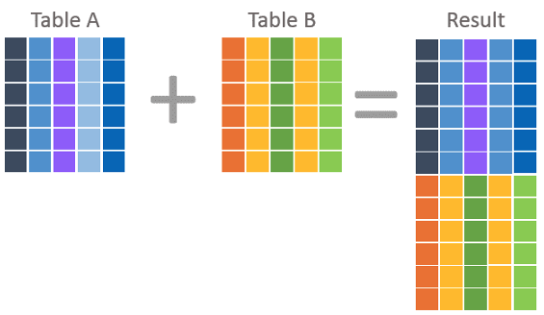
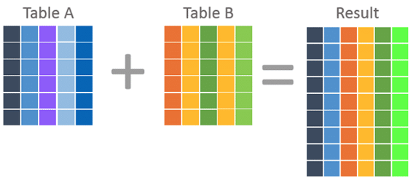
Nested Subquery
The slides that come with the book have surprisingly little material on nested subqueries.
The concept is:
Extremely important.
Students often find subqueries more confusing than joins.
The relationship/difference of subqueries to joins is often, initial unclear.
We have seen:
Union sort of puts a table on top of a table.
Join puts tables sort of puts tables side-by-side.
Subquery enables one query to call another during execution like a subfunction.

Slide 38
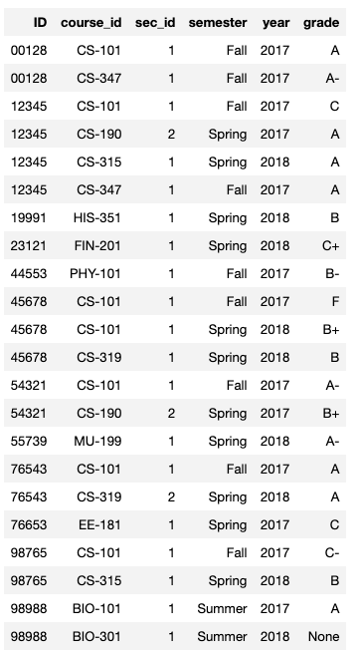
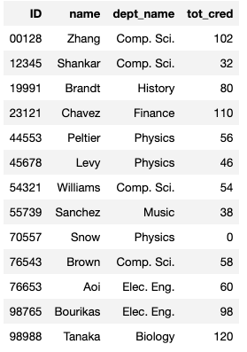
Consider Some Tables
Student
Takes

Slide 39
Consider a Subquery Tables
select *, (select name from student where student.id=takes.id) as name from takes;
Assume I wrote a function find_student_name(x)
Input is an x
Loops through all students and returns students with student.ID = x.
The query with a subquery above is like:
result = []
For t in takes:
new_r = t + find_student_name(t.id)
result.append(new_r)
Switch to Notebook
Takes
Student

Slide 40
Subqueries in the From Clause
SQL allows a subquery expression to be used in the from clause
Find the average instructors’ salaries of those departments where the average salary is greater than $42,000.”
select dept_name, avg_salary from ( select dept_name, avg (salary) as avg_salary from instructor group by dept_name) where avg_salary > 42000;
Note that we do not need to use the having clause
Another way to write above query
select dept_name, avg_salary from ( select dept_name, avg (salary) from instructor group by dept_name)
as dept_avg (dept_name, avg_salary)
where avg_salary > 42000;

Slide 41
Scalar Subquery
Scalar subquery is one which is used where a single value is expected
List all departments along with the number of instructors in each department
select dept_name, ( select count(*) from instructor where department.dept_name = instructor.dept_name) as num_instructors from department;
Runtime error if subquery returns more than one result tuple

Slide 42
Views
42 | Introduction to Databases (S22): Lecture 5: ER, Relational, SQL (IV) © Donald F. Ferguson, 2022

Slide 43
Views
In some cases, it is not desirable for all users to see the entire logical model (that is, all the actual relations stored in the database.)
Consider a person who needs to know an instructors name and department, but not the salary. This person should see a relation described, in SQL, by select ID, name, dept_name from instructor
A view provides a mechanism to hide certain data from the view of certain users.
Any relation that is not of the conceptual model but is made visible to a user as a “virtual relation” is called a view.

Slide 44
View Definition
A view is defined using the create view statement which has the form
create view v as < query expression >
where <query expression> is any legal SQL expression. The view name is represented by v.
Once a view is defined, the view name can be used to refer to the virtual relation that the view generates.
View definition is not the same as creating a new relation by evaluating the query expression
Rather, a view definition causes the saving of an expression; the expression is substituted into queries using the view.

Slide 45
View Definition and Use
A view of instructors without their salary
create view faculty as select ID, name, dept_name from instructor
Find all instructors in the Biology department
select name from faculty where dept_name = 'Biology'
Create a view of department salary totals
create view departments_total_salary(dept_name, total_salary) as select dept_name, sum (salary) from instructor group by dept_name;

Slide 46
Views Defined Using Other Views
One view may be used in the expression defining another view
A view relation v₁ is said to depend directly on a view relation v₂ if v₂ is used in the expression defining v₁
A view relation v₁ is said to depend on view relation v₂ if either v₁ depends directly to v₂ or there is a path of dependencies from v₁ to v₂
A view relation v is said to be recursive if it depends on itself.

Slide 47
Views Defined Using Other Views
create view physics_fall_2017 as select course.course_id, sec_id, building, room_number from course, section where course.course_id = section.course_id and course.dept_name = 'Physics' and section.semester = 'Fall' and section.year = '2017’;
create view physics_fall_2017_watson as select course_id, room_number from physics_fall_2017 where building= 'Watson';

Slide 48
View Expansion
Expand the view :
create view physics_fall_2017_watson as select course_id, room_number from physics_fall_2017 where building= 'Watson'
To:
create view physics_fall_2017_watson as
select course_id, room_number
from (select course.course_id, building, room_number
from course, section
where course.course_id = section.course_id
and course.dept_name = 'Physics'
and section.semester = 'Fall'
and section.year = '2017')
where building= 'Watson';

Slide 49
View Expansion (Cont.)
A way to define the meaning of views defined in terms of other views.
Let view v₁ be defined by an expression e₁ that may itself contain uses of view relations.
View expansion of an expression repeats the following replacement step:
repeat Find any view relation v_{i} in e₁ Replace the view relation v_{i} by the expression defining v_{i} until no more view relations are present in e₁
As long as the view definitions are not recursive, this loop will terminate

Slide 50
Materialized Views
Certain database systems allow view relations to be physically stored.
Physical copy created when the view is defined.
Such views are called Materialized view:
If relations used in the query are updated, the materialized view result becomes out of date
Need to maintain the view, by updating the view whenever the underlying relations are updated.

Slide 51
Update of a View
Add a new tuple to faculty view which we defined earlier
insert into faculty
values ('30765', 'Green', 'Music');
This insertion must be represented by the insertion into the instructor relation
Must have a value for salary.
Two approaches
Reject the insert
Inset the tuple
('30765', 'Green', 'Music', null)
into the instructor relation

Slide 52
Some Updates Cannot be Translated Uniquely
create view instructor_info as select ID, name, building from instructor, department where instructor.dept_name= department.dept_name;
insert into instructor_info
values ('69987', 'White', 'Taylor');
Issues
Which department, if multiple departments in Taylor?
What if no department is in Taylor?

Slide 53
And Some Not at All
create view history_instructors as select * from instructor where dept_name= 'History';
What happens if we insert
('25566', 'Brown', 'Biology', 100000)
into history_instructors?

Slide 54
View Updates in SQL
Most SQL implementations allow updates only on simple views
The from clause has only one database relation.
The select clause contains only attribute names of the relation, and does not have any expressions, aggregates, or distinct specification.
Any attribute not listed in the select clause can be set to null
The query does not have a group by or having clause.

Slide 55
Integrity Constraints
55 | Introduction to Databases (S22): Lecture 5: ER, Relational, SQL (IV) © Donald F. Ferguson, 2022

Slide 56
Integrity Constraints
Integrity constraints guard against accidental damage to the database, by ensuring that authorized changes to the database do not result in a loss of data consistency.
A checking account must have a balance greater than $10,000.00
A salary of a bank employee must be at least $4.00 an hour
A customer must have a (non-null) phone number

Slide 57
Constraints on a Single Relation
not null
primary key
unique
check (P), where P is a predicate

Slide 58
Not Null Constraints
not null
Declare name and budget to be not null
name varchar(20) not null budget numeric(12,2) not null

Slide 59
Unique Constraints
unique ( A₁, A₂, …, A_{m})
The unique specification states that the attributes A₁, A₂, …, A_{m} form a candidate key.
Candidate keys are permitted to be null (in contrast to primary keys).

Slide 60
The check clause
The check (P) clause specifies a predicate P that must be satisfied by every tuple in a relation.
Example: ensure that semester is one of fall, winter, spring or summer
create table section
(course_id varchar (8),
sec_id varchar (8),
semester varchar (6),
year numeric (4,0),
building varchar (15),
room_number varchar (7),
time slot id varchar (4),
primary key (course_id, sec_id, semester, year),
check (semester in ('Fall', 'Winter', 'Spring', 'Summer')))

Slide 61
Referential Integrity
Ensures that a value that appears in one relation for a given set of attributes also appears for a certain set of attributes in another relation.
Example: If “Biology” is a department name appearing in one of the tuples in the instructor relation, then there exists a tuple in the department relation for “Biology”.
Let A be a set of attributes. Let R and S be two relations that contain attributes A and where A is the primary key of S. A is said to be a foreign key of R if for any values of A appearing in R these values also appear in S.

Slide 62
Referential Integrity (Cont.)
Foreign keys can be specified as part of the SQL create table statement
foreign key (dept_name) references department
By default, a foreign key references the primary-key attributes of the referenced table.
SQL allows a list of attributes of the referenced relation to be specified explicitly.
foreign key (dept_name) references department (dept_name)

Slide 63
Cascading Actions in Referential Integrity
When a referential-integrity constraint is violated, the normal procedure is to reject the action that caused the violation.
An alternative, in case of delete or update is to cascade
create table course ( (… dept_name varchar(20), foreign key (dept_name) references department on delete cascade on update cascade, . . .)
Instead of cascade we can use :
set null,
set default

Slide 64
Integrity Constraint Violation During Transactions
Consider:
create table person ( ID char(10), name char(40), mother char(10), father char(10), primary key ID, foreign key father references person, foreign key mother references person)
How to insert a tuple without causing constraint violation?
Insert father and mother of a person before inserting person
OR, set father and mother to null initially, update after inserting all persons (not possible if father and mother attributes declared to be not null)
OR defer constraint checking

Slide 65
Complex Check Conditions
The predicate in the check clause can be an arbitrary predicate that can include a subquery.
check (time_slot_id in (select time_slot_id from time_slot))
The check condition states that the time_slot_id in each tuple in the section relation is actually the identifier of a time slot in the time_slot relation.
The condition has to be checked not only when a tuple is inserted or modified in section , but also when the relation time_slot changes

Slide 66
Assertions
An assertion is a predicate expressing a condition that we wish the database always to satisfy.
The following constraints, can be expressed using assertions:
For each tuple in the student relation, the value of the attribute tot_cred must equal the sum of credits of courses that the student has completed successfully.
An instructor cannot teach in two different classrooms in a semester in the same time slot
An assertion in SQL takes the form:
create assertion <assertion-name> check (<predicate>);

Slide 67
Built-in Data Types in SQL
date: Dates, containing a (4 digit) year, month and date
Example: date '2005-7-27'
time: Time of day, in hours, minutes and seconds.
Example: time '09:00:30' time '09:00:30.75'
timestamp: date plus time of day
Example: timestamp '2005-7-27 09:00:30.75'
interval: period of time
Example: interval '1' day
Subtracting a date/time/timestamp value from another gives an interval value
Interval values can be added to date/time/timestamp values

Slide 68
Large-Object Types
Large objects (photos, videos, CAD files, etc.) are stored as a large object:
blob: binary large object -- object is a large collection of uninterpreted binary data (whose interpretation is left to an application outside of the database system)
clob: character large object -- object is a large collection of character data
When a query returns a large object, a pointer is returned rather than the large object itself.

Slide 69
User-Defined Types
create type construct in SQL creates user-defined type
create type Dollars as numeric (12,2) final
Example:
create table department (dept_name varchar (20), building varchar (15), budget Dollars);

Slide 70
Domains
create domain construct in SQL-92 creates user-defined domain types
create domain person_name char(20) not null
Types and domains are similar. Domains can have constraints, such as not null, specified on them.
Example:
create domain degree_level varchar(10) constraint degree_level_test check (value in ('Bachelors', 'Masters', 'Doctorate'));

Slide 71
Indexes
71 | Introduction to Databases (S22): Lecture 5: ER, Relational, SQL (IV) © Donald F. Ferguson, 2022

Slide 72
Index Creation
Many queries reference only a small proportion of the records in a table.
It is inefficient for the system to read every record to find a record with particular value
An index on an attribute of a relation is a data structure that allows the database system to find those tuples in the relation that have a specified value for that attribute efficiently, without scanning through all the tuples of the relation.
We create an index with the create index command
create index <name> on <relation-name> (attribute);

Slide 73
Index Creation Example
create table student (ID varchar (5), name varchar (20) not null, dept_name varchar (20), tot_cred numeric (3,0) default 0, primary key (ID))
create index studentID_index on student(ID)
The query:
select * from student where ID = '12345'
can be executed by using the index to find the required record, without looking at all records of student

Slide 74
Let’s Practice
Primary
Unique
Unique and Not Null
Index

Slide 75
Some Advanced ER Concepts
75 | Introduction to Databases (S22): Lecture 5: ER, Relational, SQL (IV) © Donald F. Ferguson, 2022

Slide 76
Weak Entity Sets
Consider a section entity, which is uniquely identified by a course_id, semester, year, and sec_id.
Clearly, section entities are related to course entities. Suppose we create a relationship set sec_course between entity sets section and course.
Note that the information in sec_course is redundant, since section already has an attribute course_id, which identifies the course with which the section is related.
One option to deal with this redundancy is to get rid of the relationship sec_course; however, by doing so the relationship between section and course becomes implicit in an attribute, which is not desirable.

Slide 77
Weak Entity Sets (Cont.)
An alternative way to deal with this redundancy is to not store the attribute course_id in the section entity and to only store the remaining attributes section_id, year, and semester.
However, the entity set section then does not have enough attributes to identify a particular section entity uniquely
To deal with this problem, we treat the relationship sec_course as a special relationship that provides extra information, in this case, the course_id, required to identify section entities uniquely.
A weak entity set is one whose existence is dependent on another entity, called its identifying entity
Instead of associating a primary key with a weak entity, we use the identifying entity, along with extra attributes called discriminator to uniquely identify a weak entity.

Slide 78
Weak Entity Sets (Cont.)
An entity set that is not a weak entity set is termed a strong entity set.
Every weak entity must be associated with an identifying entity; that is, the weak entity set is said to be existence dependent on the identifying entity set.
The identifying entity set is said to own the weak entity set that it identifies.
The relationship associating the weak entity set with the identifying entity set is called the identifying relationship.
Note that the relational schema we eventually create from the entity set section does have the attribute course_id, for reasons that will become clear later, even though we have dropped the attribute course_id from the entity set section.

Slide 79
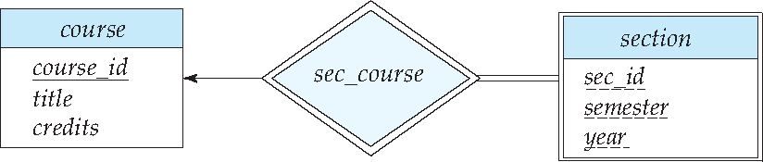
Expressing Weak Entity Sets
In E-R diagrams, a weak entity set is depicted via a double rectangle.
We underline the discriminator of a weak entity set with a dashed line.
The relationship set connecting the weak entity set to the identifying strong entity set is depicted by a double diamond.
Primary key for section – (course_id, sec_id, semester, year)

Slide 80
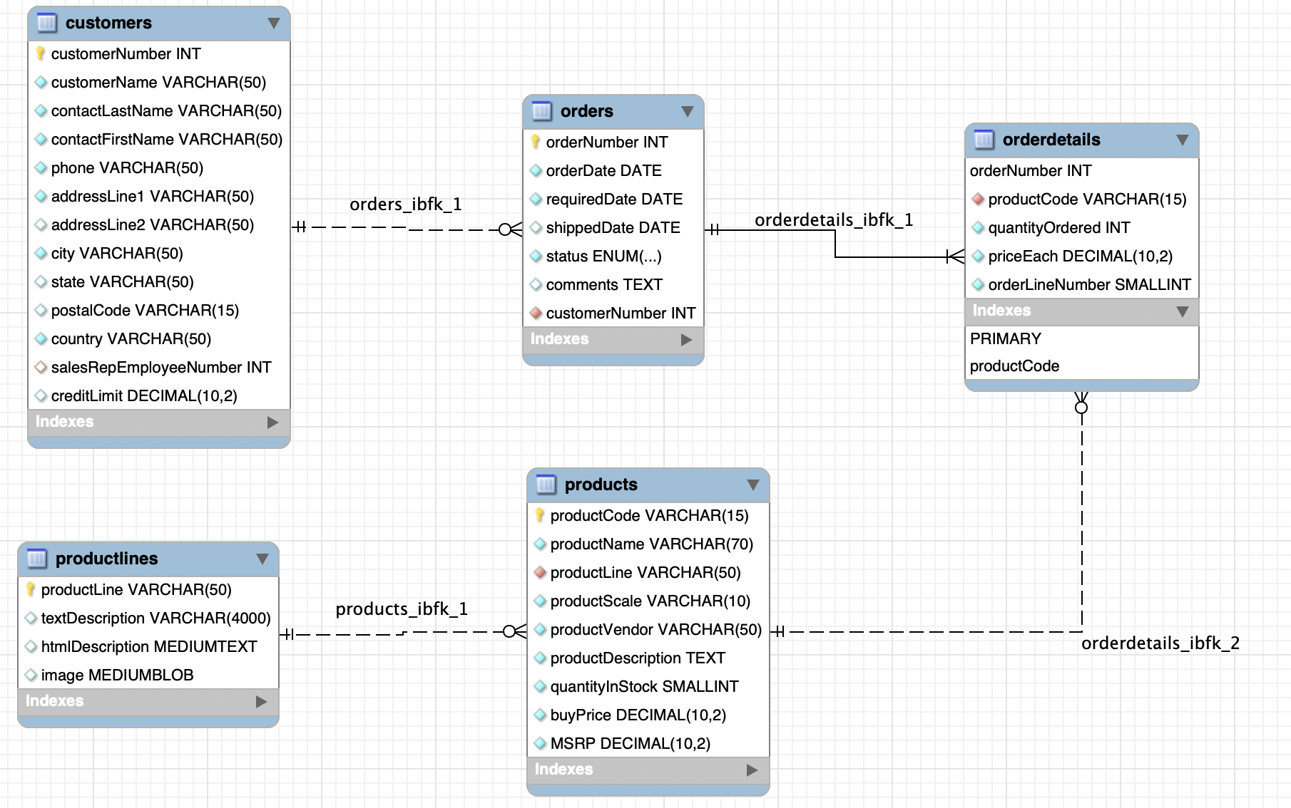
An Example – Classic Models
https://www.mysqltutorial.org/mysql-sample-database.aspx/
80 | Introduction to Databases (F21): Lecture 5: ER, Relational, SQL (IV)

Slide 81
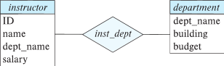
Redundant Attributes
Suppose we have entity sets:
instructor, with attributes: ID, name, dept_name, salary
department, with attributes: dept_name, building, budget
We model the fact that each instructor has an associated department using a relationship set inst_dept
The attribute dept_name in instructor replicates information present in the relationship and is therefore redundant
and needs to be removed.
BUT: when converting back to tables, in some cases the attribute gets reintroduced, as we will see later.

Slide 82
Design Alternatives
In designing a database schema, we must ensure that we avoid two major pitfalls:
Redundancy: a bad design may result in repeat information.
Redundant representation of information may lead to data inconsistency among the various copies of information
Incompleteness: a bad design may make certain aspects of the enterprise difficult or impossible to model.
Avoiding bad designs is not enough. There may be a large number of good designs from which we must choose.
Emphasis Added
Notes:
82

Slide 83
Aggregation
Consider the ternary relationship proj_guide, which we saw earlier
Suppose we want to record evaluations of a student by a guide on a project

Slide 84
Aggregation (Cont.)
Relationship sets eval_for and proj_guide represent overlapping information
Every eval_for relationship corresponds to a proj_guide relationship
However, some proj_guide relationships may not correspond to any eval_for relationships
So we can’t discard the proj_guide relationship
Eliminate this redundancy via aggregation
Treat relationship as an abstract entity
Allows relationships between relationships
Abstraction of relationship into new entity

Slide 85
Aggregation (Cont.)
Eliminate this redundancy via aggregation without introducing redundancy, the following diagram represents:
A student is guided by a particular instructor on a particular project
A student, instructor, project combination may have an associated evaluation
Notes:
85

Slide 86
Reduction to Relational Schemas
To represent aggregation, create a schema containing
Primary key of the aggregated relationship,
The primary key of the associated entity set
Any descriptive attributes
In our example:
The schema eval_for is:
eval_for (s_ID, project_id, i_ID, evaluation_id)
The schema proj_guide is redundant.

Slide 87
Specialization
Top-down design process; we designate sub-groupings within an entity set that are distinctive from other entities in the set.
These sub-groupings become lower-level entity sets that have attributes or participate in relationships that do not apply to the higher-level entity set.
Depicted by a triangle component labeled ISA (e.g., instructor “is a” person).
Attribute inheritance – a lower-level entity set inherits all the attributes and relationship participation of the higher-level entity set to which it is linked.

Slide 88
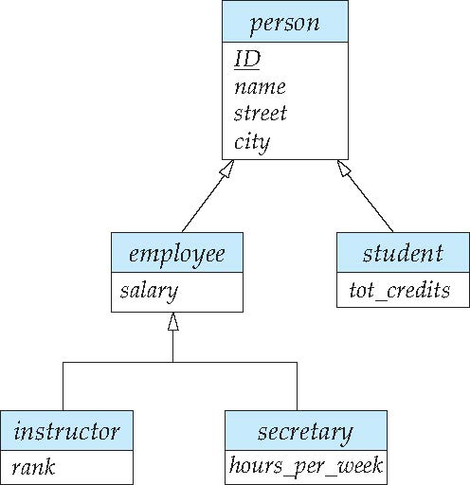
Specialization Example
Overlapping – employee and student
Disjoint – instructor and secretary
Total and partial

Slide 89
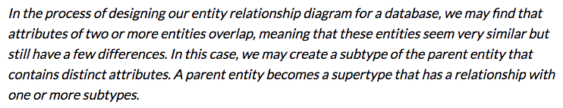
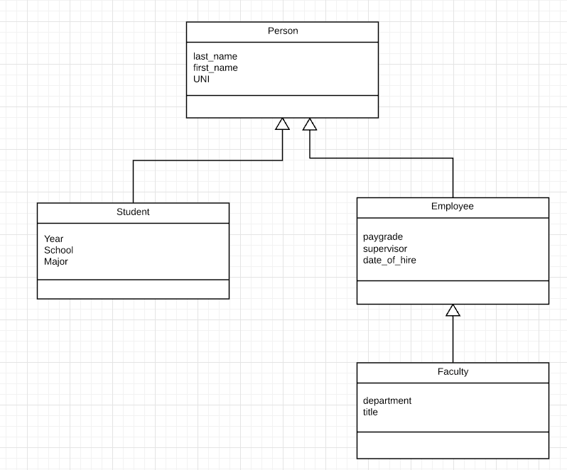
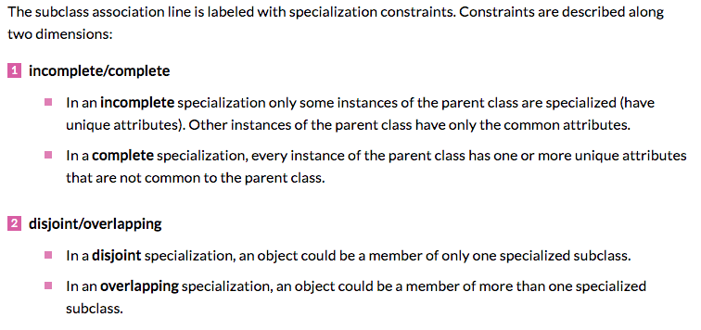
Inheritance, IsA, Specialization
Are all employees faculty?
Can students also be employees?
http://www.vertabelo.com/blog/technical-articles/inheritance-in-a-relational-database
89 | W4111_02_F20: Introduction to Databases – Lecture 6

Slide 90
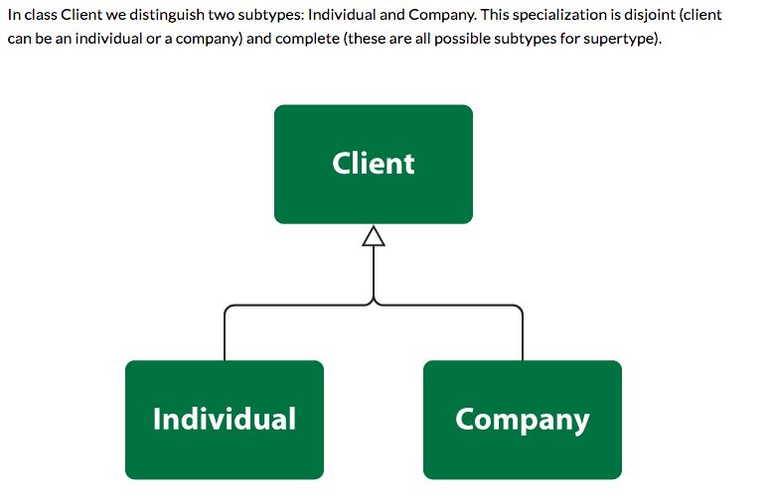
Simpler Example
90 | W4111_02_F20: Introduction to Databases – Lecture 6

Slide 91
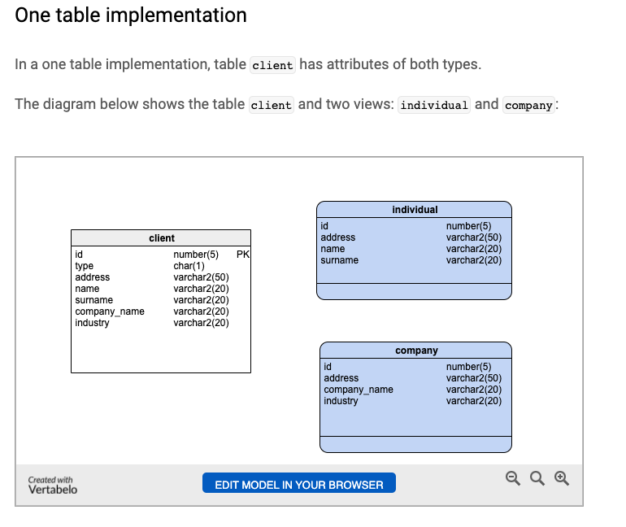
One Table Implementation
Views
Tables

Slide 92
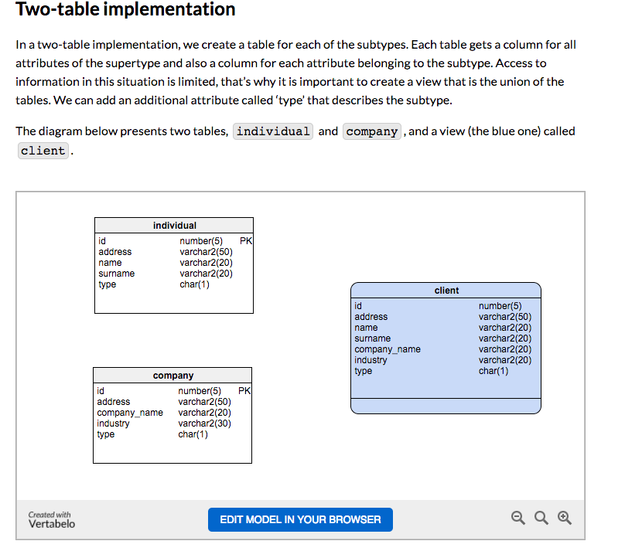
Two Table Implementation
View
Tables
92 | W4111_02_F20: Introduction to Databases – Lecture 6

Slide 93
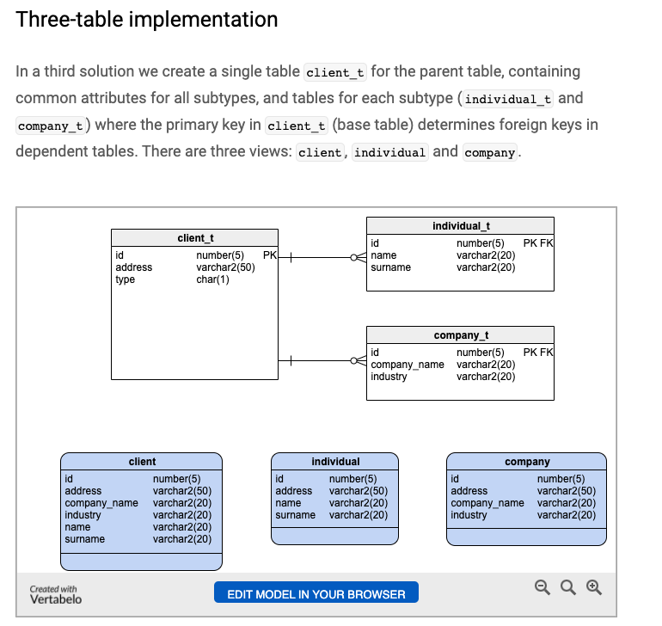
Two Table Implementation
Tables
Views
93 | W4111_02_F20: Introduction to Databases – Lecture 6

Slide 94
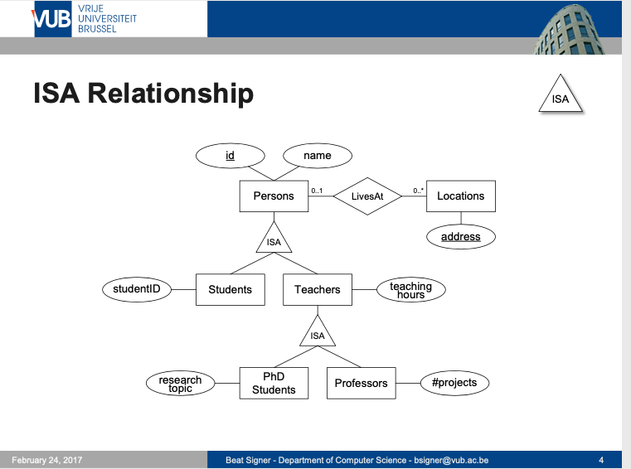
Modeling
94 | W4111_02_F20: Introduction to Databases – Lecture 6

Slide 95
ER vs. UML Class Diagrams
ER Diagram Notation
Equivalent in UML
I use this approach in Crow’s Foot Notation but that is not standard.
* Generalization can use merged or separate arrows independent
of disjoint/overlapping

Slide 96
Faculty, Student Inheritance Example
96 | Introduction to Databases (S22): Lecture 5: ER, Relational, SQL (IV) © Donald F. Ferguson, 2022

